Slide 1
Presentation 11/09/12
Andrew Wang

Slide 2
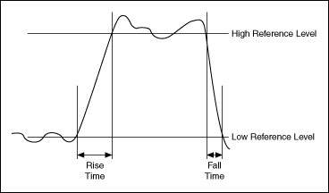
Rise Time and Fall Time
Rise Time – Time required for a low value signal (10%) to a high value signal (90%).
Fall Time – Time required for signal to fall from a high value (90%) to a low value (10%).

Slide 3
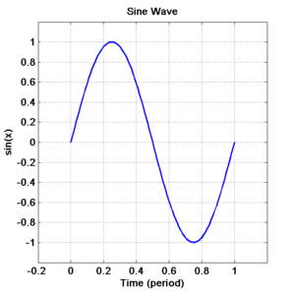
Sample Calculation
For sine wave:
A sine wave with amplitude 1.0 has:
Amp_min = -1.0
Amp_max = 1.0
Peak to peak amplitude (ppk) = 2.0
10% level: -1.0 + 0.1*2.0 = -0.8
90% level: 1.0 – 0.1*2.0 = 0.8
ArcSin(-0.8) = -.9273
ArcSin(0.8) = .9273
Rise time = .9273 - (-.9273) = 1.8546
Same as calculating the Fall Time.

Slide 4
Waveforms
Vornado Fan (FAN):
HP pavilion dm4 Laptop (HP):

Slide 5
Waveforms
2011 Direct TV Set-Top-Box (STB):
Sharp TV (TV):

Slide 6
Results
 | Amplitude (average) | Rise Time | Fall Time
FAN | 10.1 | 0.0045 | 0.0046
HP | 5.8 | 0.0077 | 0.0078
STB | 1.88 | 0.008 | 0.0078
TV | 3.2 | 0.0048 | 0.0047
Single Appliances
 | Amplitude (average) | Rise Time | Fall Time
HP+FAN | 15.65 | 0.0078 | 0.0077
HP+TV | 9.2 | 0.008 | 0.0079
HP+TV+FAN | 18.6 | 0.0075 | 0.007
STB+FAN | 12.1 | 0.0061 | 0.0063
STB+FAN+HP | 17.8 | 0.0077 | 0.0078
STB+FAN+HP+TV | 21.8 | 0.0077 | 0.0078
STB+FAN+TV | 15.6 | 0.0056 | 0.006
STB+HP | 8.1 | 0.008 | 0.0079
STB+HP+TV | 17.4 | 0.008 | 0.0081
STB+TV | 5.55 | 0.0073 | 0.0072
TV+FAN | 13.1 | 0.0047 | 0.0046
Combined Appliances

Slide 7
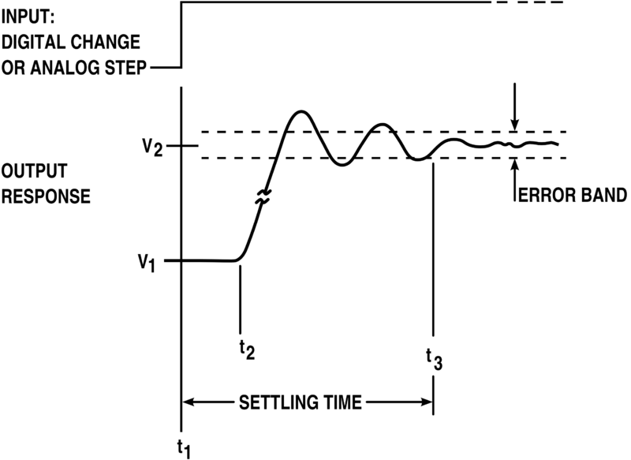
Settling Time
The time required for a component, circuit, device, instrument, piece of equipment, or system, to settle and remain at a given value once an input signal or pulse is received.

